Slide 1

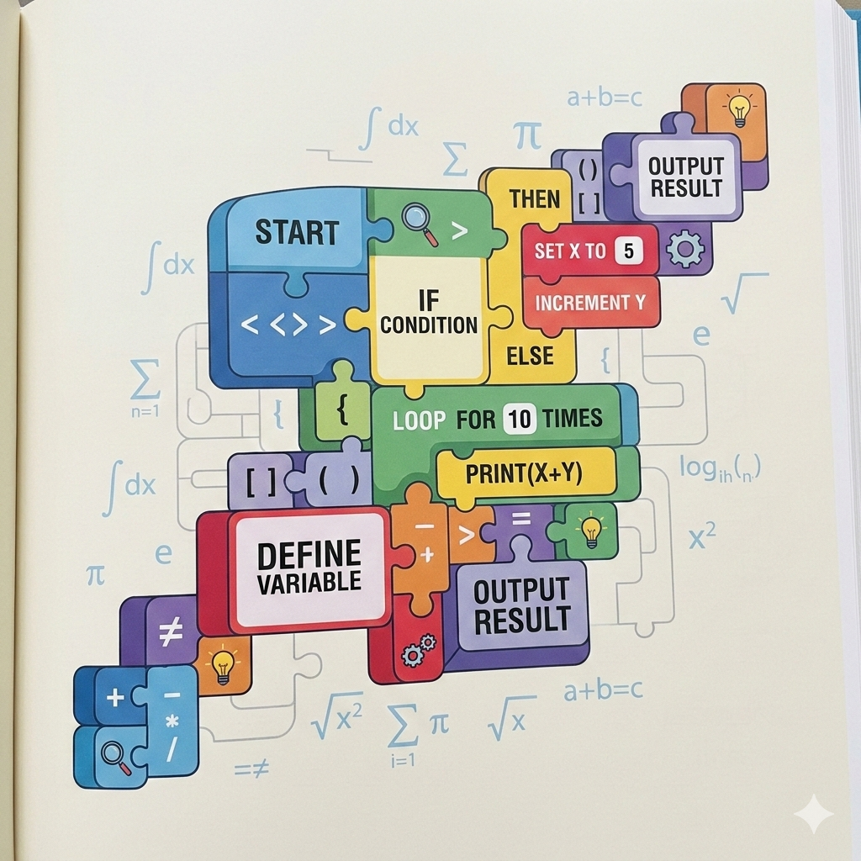
LEARNWITHVARSHHH // PYTHON-SERIES
Introduction: What Are Python Operators?
The building blocks of computation and logic in Python.
Operators are special symbols that perform computations on variables and values, which are known as operands. They form the absolute foundation of all data manipulation and logical flow in programming, acting as the verbs in Python's syntax.

Slide 2
LEARNWITHVARSHHH // PYTHON-SERIES
Arithmetic Operators
Mathematical Computations
STANDARD OPERATORS
SPECIALIZED PYTHON OPERATORS
Perform fundamental mathematical operations on numerical values.
//
Floor Division
Returns integer result (rounds down)
+
Addition
Adds values
-
Subtraction
Subtracts values
%
Modulus
Finds remainder of division
*
Multiplication
Multiplies values
/
Division
Divides values
**
Exponentiation
Calculates powers (e.g., base ** exp)
ORDER OF PRECEDENCE (PEMDAS)
Python evaluates expressions using standard mathematical order of precedence (PEMDAS), ensuring predictable calculations from basic arithmetic to complex algorithmic formulas.

Slide 3

LEARNWITHVARSHHH // PYTHON-SERIES
Comparison Operators
Evaluating Conditions & Relationships
Comparison operators, also known as relational operators, compare two values and determine the relationship between them. They evaluate conditions using symbols like equal to (==), not equal to (!=), greater than (>), less than (<), >=, and <=.
EVALUATION RESULT: TRUE
CRITICAL FOUNDATION
Boolean Decision-Making
The result of any comparison operation is strictly a Boolean value: either True or False.
When a condition evaluates to True, it allows programs to execute designated conditional execution paths.
Control Flow & Data Relations
These operators form the critical foundation for decision-making structures in software architecture.
They enable dynamic branching, allowing programs to execute completely different paths based on underlying data relationships.

Slide 4
LEARNWITHVARSHHH // PYTHON-SERIES
Logical Operators: Combining Truth Values
Logical operators allow programmers to combine multiple conditional statements.
'and' Operator
All Conditions True
Requires all conditions to be true.
'or' Operator
At Least One True
Requires only one condition to be true.
'not' Operator
Inverts Truth Value
Reverses the current truth value.
Optimization // Short-Circuit Evaluation
Python utilizes short-circuit evaluation, meaning it stops evaluating a logical expression as soon as the final outcome is determined. This optimization improves performance and prevents unnecessary computations when processing complex truth value combinations.

Slide 5
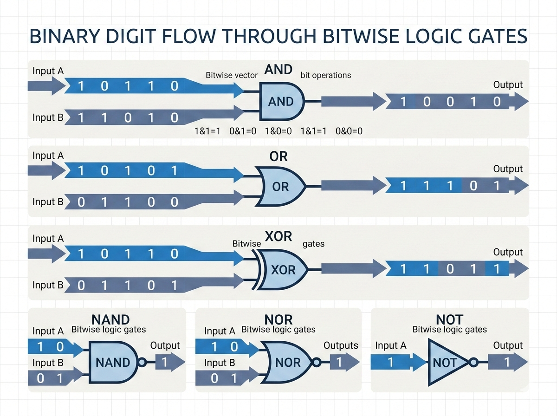
LEARNWITHVARSHHH // PYTHON-SERIES
Bitwise Operators: Manipulating Binary Digits
Fundamental Bit-Level Operations
Bitwise operators manipulate data at its most fundamental level: binary digits (bits).
Instead of processing standard integers, these operators evaluate the underlying 1s and 0s. Key operations include AND (&), OR (|), XOR (^), and NOT (~).
Additionally, left shift (<<) and right shift (>>) move bits across memory locations, effectively multiplying or dividing by powers of two.
Applications:
These operators are essential for low-level systems programming, cryptography, and performance optimization.

Slide 6
LEARNWITHVARSHHH // PYTHON-SERIES
Assignment Operators
Storing & Modifying Values
Assignment operators are used to store and update values within variables.
SIMPLE ASSIGNMENT (=)
The fundamental assignment operator (=) binds a value to a variable name.
COMPOUND ASSIGNMENT (+=, -=, *=, /=)
To streamline code, Python offers compound assignment operators like +=, -=, and *=.
These combine an arithmetic or bitwise operation with assignment in a single step. For example, an addition assignment directly updates a variable's existing value by adding a new amount, making iterative processes cleaner and more efficient.
# Binds 10 to variable name 'x'
x = 10
x += 5 # Equivalent to: x = x + 5

Slide 7
LEARNWITHVARSHHH // PYTHON-SERIES
Special Operators: Identity & Membership
Python features special operators for advanced evaluations and structural checks.
IDENTITY OPERATORS
is and is not
Check if two variables point to the exact same object in memory. This is distinctly different from checking if their values are merely equal.
MEMBERSHIP OPERATORS
in and not in
Test whether a specific sequence or value exists within a collection, such as a list, tuple, or string.
KEY TAKEAWAY: MEMORY LOCATION VS. VALUE EQUALITY
These operators provide highly readable, English-like syntax for complex memory and structural checks. Always distinguish between identity (is) which validates memory references, and equality (==) which checks content matching.

Slide 8
NEXT CLASS & RESOURCES
Getting User Input in Python
In our next session, we will transition from internal operations to interactive programming by exploring 'Getting User Input in Python'. You will learn how to capture and process data directly from users.
LEARNWITHVARSHHH
PYTHON
SERIES
CURRENT MODULE
Core Foundations
UPCOMING
Interactive Input
STUDY MATERIALS & DOCUMENTATION
Access Course Notes & Repository Updates
To review today's conceptual breakdown, access the complete study materials and documentation.
# Follow the repository and navigate to the section below for updates:
github.com/Varshh-hub / PYTHON-SERIES
input_demo.py

